Slide 1
CSE 6305 Programming Languages and Systems

Slide 2
Programming languages suck.

Slide 3
wtf?

Slide 4
*all of these numbers are pretty meaningless
Source: Phil Johnson, IT World, 25/9/13

Slide 5
a little JavaScript …
$ jsc
>
[] + []
>
[] + {}
[object Object]
>
{} + []
0
>
{} + {}
NaN
Source: Gary Bernhardt CodeMash 2012

Slide 6
a little more JavaScript …
$ jsc
>
Array(14)
,,,,,,,,,,,,,,
>
Array(14).join("foo")
foofoofoofoofoofoofoofoofoofoofoofoofoofoo
>
Array(14).join("foo" + 1)
foo1foo1foo1foo1foo1foo1foo1foo1foo1foo1foo1foo1foo1foo1
>
Array(14).join("foo" - 1)
+ "Batman!"
NaNNaNNaNNaNNaNNaNNaNNaNNaNNaNNaNNaNNaNNaN Batman!
Source: Gary Bernhardt CodeMash 2012

Slide 7
some PHP …
<?php
$A = array();
$A[0] = 5;
echo "A[0]: $A[0]";
?>
A[0]: 5

Slide 8
some PHP …
<?php
$A = array();
$A[0] = 5;
echo "A[0]: $A[0]";
?>
$C = $A;
$C[0] = 10;
A[0]: 5

Slide 9
PHP Semantics
In PHP, variables are always assigned by value.
That is to say, when you assign an expression to a variable, the entire value of the original expression is copied into the destination variable.
This means, for instance, that after assigning one variable's value to another, changing one of those variables will have no effect on the other.

Slide 10
some PHP …
<?php
$A = array();
$A[0] = 5;
$C = $A;
$C[0] = 10;
echo "A[0]: $A[0]";
?>
$b = &$A[0];
A[0]: 10

Slide 11
some PHP …
<?php
$A = array();
$A[0] = 5;
$b = &$A[0];
$C = $A;
$C[0] = 10;
echo "A[0]: $A[0]";
?>
unset($b);
A[0]: 5

Slide 14
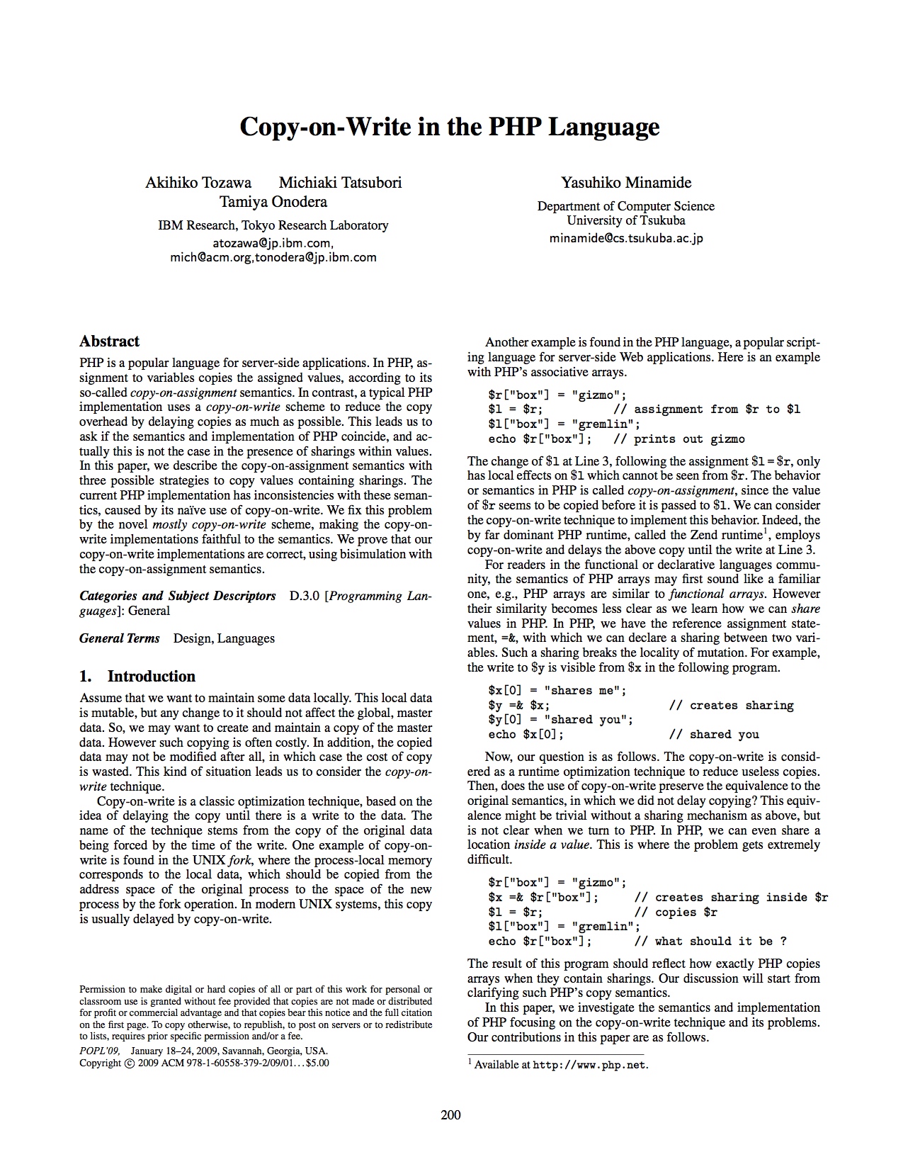
POPL’09

Slide 15
PHP …
“I don’t know how to stop it, there was never any intent to write a programming language […] I have absolutely no idea how to write a programming language, I just kept adding the next logical step on the way.”
Rasmus Lerdorf, creator of PHP

Slide 16
some Python …
C
Python
int NUM = 111181111;
int is_prime(int n) {
int i;
for(i = 2; i < n; i++) {
if (n % i == 0) {
return 0;
}
}
return 1;
}
NUM = 111181111
def is_prime(n):
i = 2
while i < n:
if n % i == 0:
return False
i += 1
return True
C (GCC, O0): 0.624s
Python: 15.609s
25x difference!

Slide 17
some Java …
List<int> il = new ArrayList<int>();

Slide 18
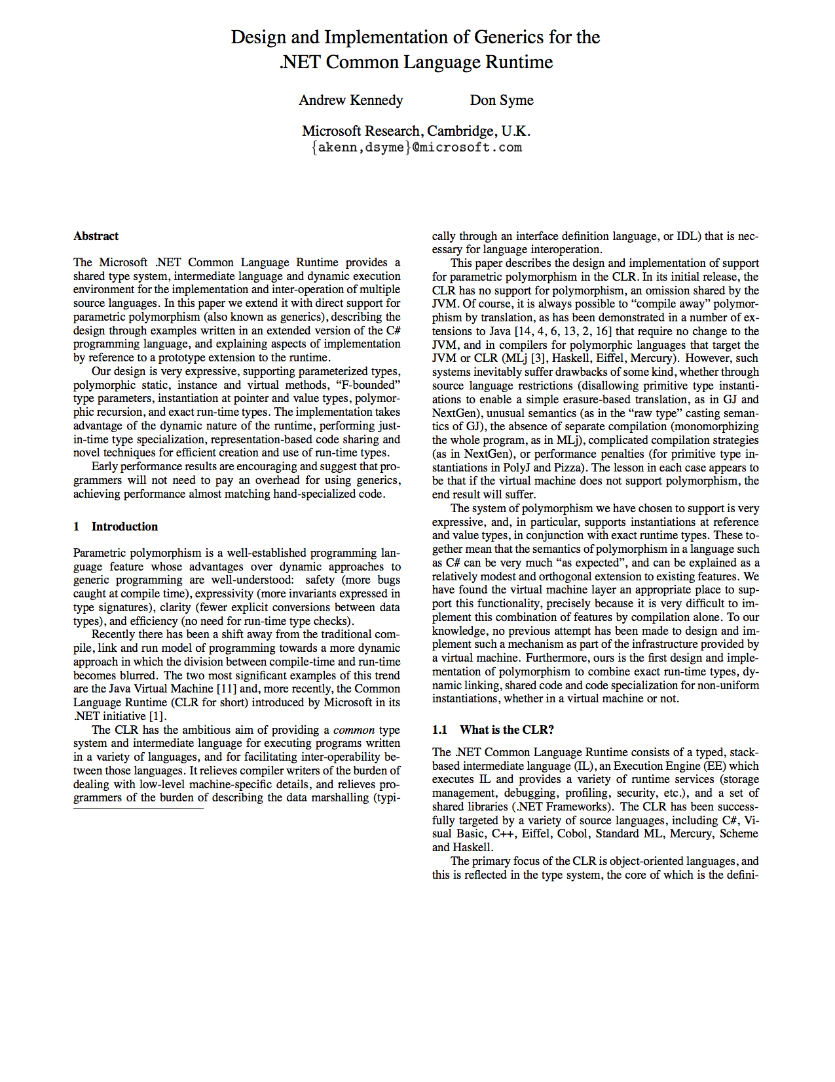
PLDI’01

Slide 19
Security

Slide 20
Security Attacks on Java

Slide 21
Security Attacks on Java

Slide 22
PHP Vulnerabilities

Slide 23
PHP Vulnerabilities

Slide 24
JavaScript Vulnerabilities

Slide 25
a double-edged sword
Rich libraries
Built in safety
Strong abstractions
Less opportunity for programmer errors
But language itself presents a bigger target

Slide 26
Performance

Slide 27
*all of these numbers are pretty meaningless
Source: http://benchmarksgame.alioth.debian.org

Slide 28
*all of these numbers are pretty meaningless
Source: http://benchmarksgame.alioth.debian.org

Slide 29
*all of these numbers are pretty meaningless
Source: http://benchmarksgame.alioth.debian.org

Slide 30
Existing Approaches

Slide 31
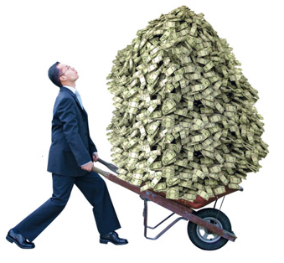
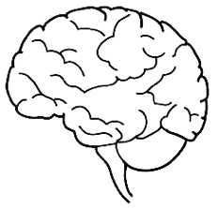



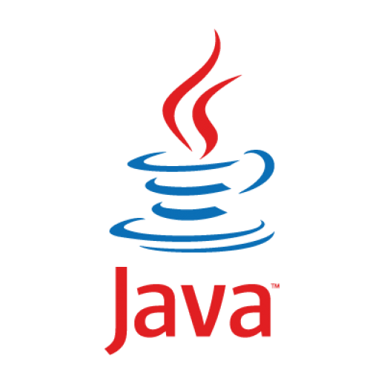


Approach 1: Build VM From Scratch

Slide 32
Approach 2: Existing VM
Semantic gap
Jython
JVM
Huge dependencies

Slide 33
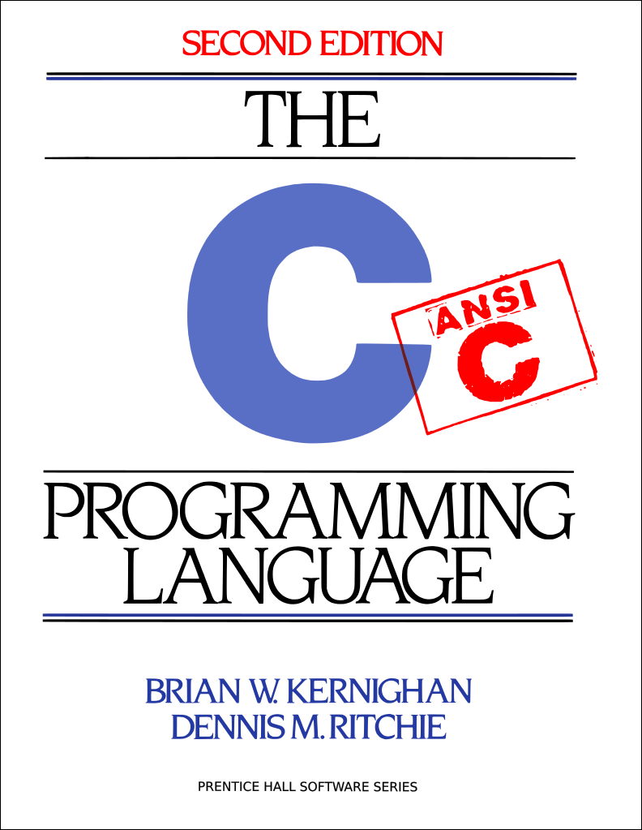

Approach 3: Existing Frameworks
LLVM
Excellent for C/C++/ObjectiveC
Not for managed languages
Author

Slide 34
What is so difficult?

Slide 35
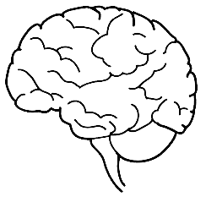
Three Foundamental Concerns
Just-in-time Compiling
Concurrency
Garbage Collection

Slide 36
JIT + concurrency + GC

Slide 37


Concurrency
Atomic ops.
Memory model
Concurrent GC
Parallel GC
Yieldpoints
GC Barriers
Transactional Memory
Object map
Stack map
JIT
GC

Slide 38
Language Implementations
Lang. Impl.
Concurrency
Execution
GC
HotSpot
✔ Threads
✔ JIT
✔ Generational
CPython
✖ GIL
✖ Interpreter
✖ Naïve RC
PyPy
✖ STM (exp.)
✔ JIT
✔ MMTK-like
Jython
✔ JVM Threads
✖ JVM JIT
✔ JVM GC
Unladen Swallow
✖ GIL
✖ Template JIT
✖ Naïve RC
Ruby
✖ GIL
✖ Interpreter
✖ MS
PHP
-
✖ Interpreter
✖ Naïve RC
HHVM
-
✔ JIT
✖ Naïve RC
Lua
✖ No Threads
✖ Interpreter
✖ MS
LuaJit
✖ No Threads
✔ JIT
✖ MS

Slide 39
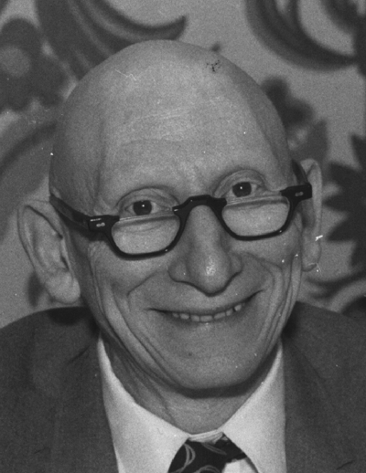
Alan J Perlis 1/4/1922 – 2/7/1990 Turing Award 1966 Compiler construction, ALGOL

Slide 40
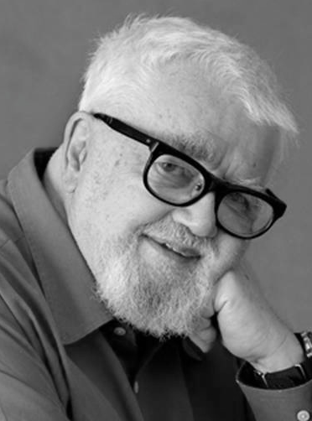
John McCarthy 4/9/1927 – 24/10/2011 Turing Award 1971 Lisp, garbage collection

Slide 41
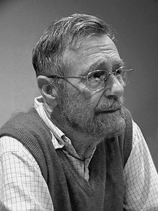
Edsger Dijkstra 11/5/1930 – 6/8/2002 Turing Award 1972
compilers, garbage collection

Slide 42
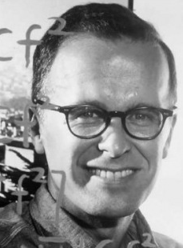
John Backus 3/12/1924 – 17/3/2007 Turing Award 1977
compilers, FORTRAN, ALGOL, BNF, functional languages

Slide 43
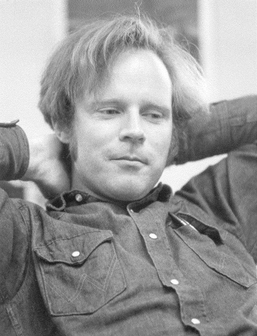
Robert Floyd 8/6/1936 – 25/9/2001 Turing Award 1978
parsing, pl semantics, program verification, synthesis

Slide 44
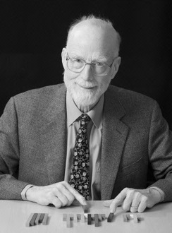
Tony Hoare 11/1/1934 – Turing Award 1980
ALOGOL 60, CSP, PL specification, monitors

Slide 45
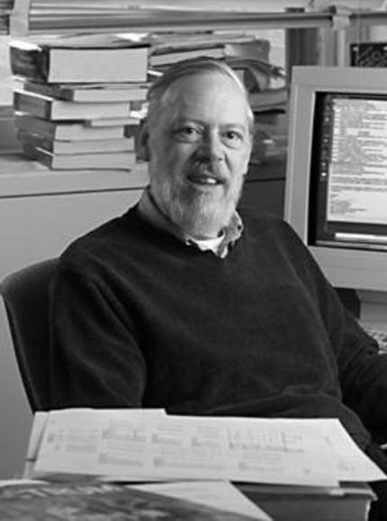
Dennis Ritchie 9/9/41 – 12/10/2011 Turing Award 1983
ALTRAN, B, BCPL, C

Slide 46
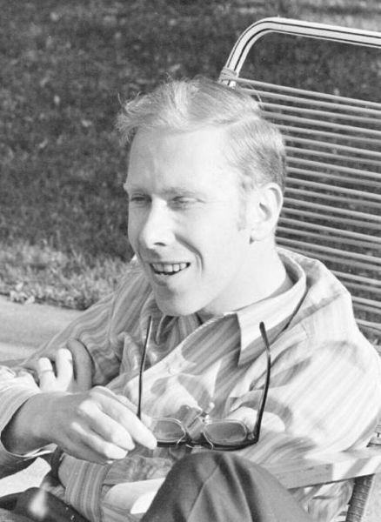
Niklaus Wirth 15/2/34 – Turing Award 1984
Euler, Algol W, Pascal, Modula, Modula-2, Oberon, Oberon-2

Slide 47
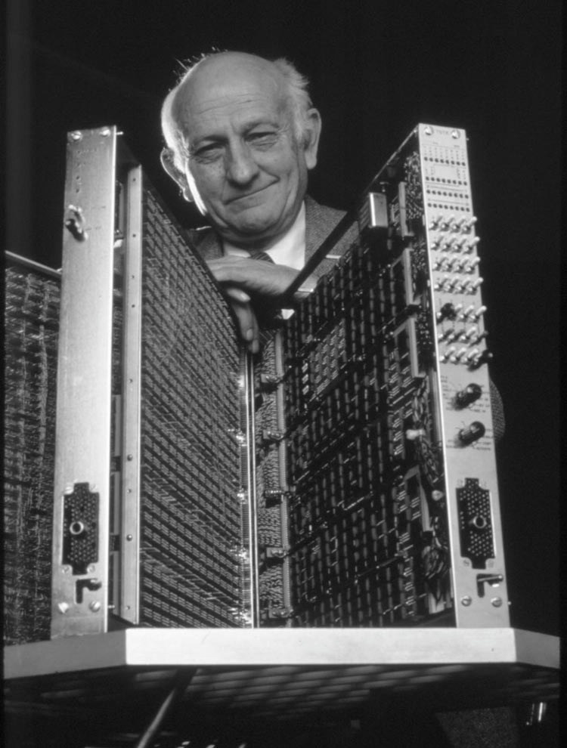
John Cocke 30/5/1925 – 16/7/2002 Turing Award 1987
compiler design, optimizing compiler design

Slide 48
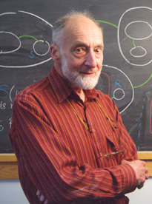
Robin Milner 13/1/1934 – 20/3/2010 Turing Award 1991
ML, automated theorem proving, pi-calculus

Slide 49
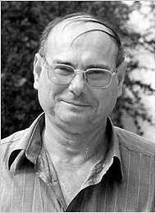
Amir Pnueli 22/4/1941 – 2/11/2009 Turing Award 1996
temporal logic, concurrent systems, program verification

Slide 50
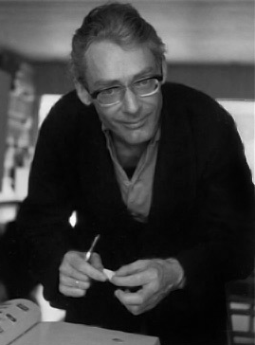
Ole-Johan Dhal 12/10/1931 – 29/6/2002 Turing Award 2001
Object-oriented programming, Simula

Slide 51
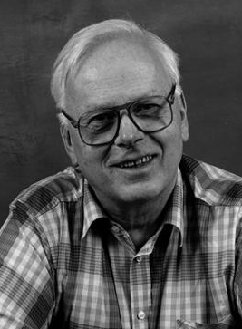
Kristen Nygaard 27/8/1926 – 10/8/2002 Turing Award 2001
Object-oriented programming, Simula

Slide 52
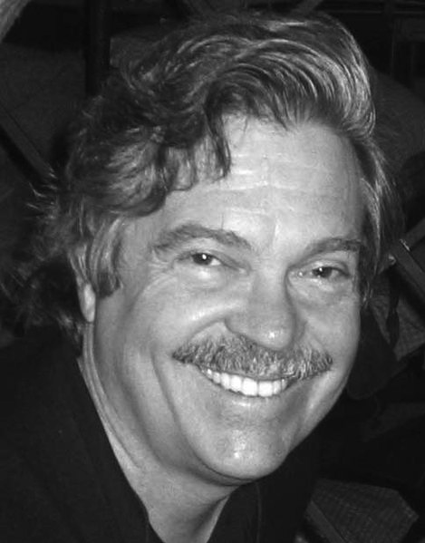
Alan Kay 17/5/1940 – Turing Award 2003
object-oriented programming, smalltalk

Slide 53
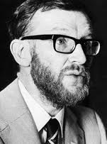
Peter Naur 8/6/1936 – 25/9/2001 Turing Award 2005
ALGOL, BNF

Slide 54
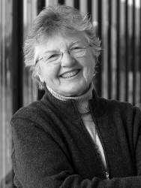
Fran Allen 4/8/1932 – Turing Award 2006
compilers, optimizing compilers, parallel compilers

Slide 55
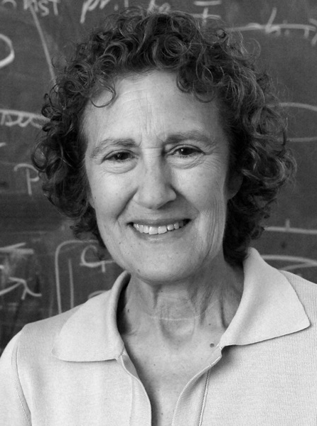
Barbara Liskov 8/6/1936 – 25/9/2001 Turing Award 2008
CLU, ARGUS, data abstraction, distributed computing

